Slide 1
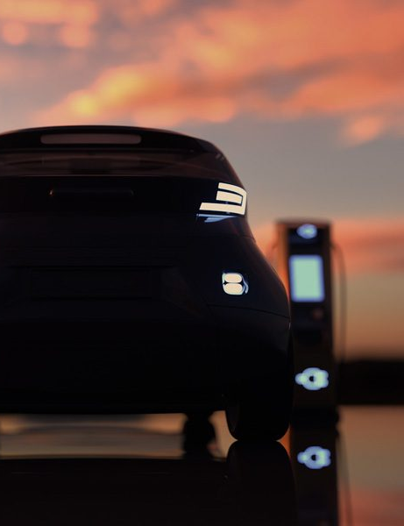

Load Forecasting Using Learning Techniques
EV Charging Stations
Final Presentation
26th January 2023

Slide 2

Overview Context Objective Methodology Results Analysis of Results Conclusion & Prospective
Outline

Slide 3


01
Overview

Slide 4
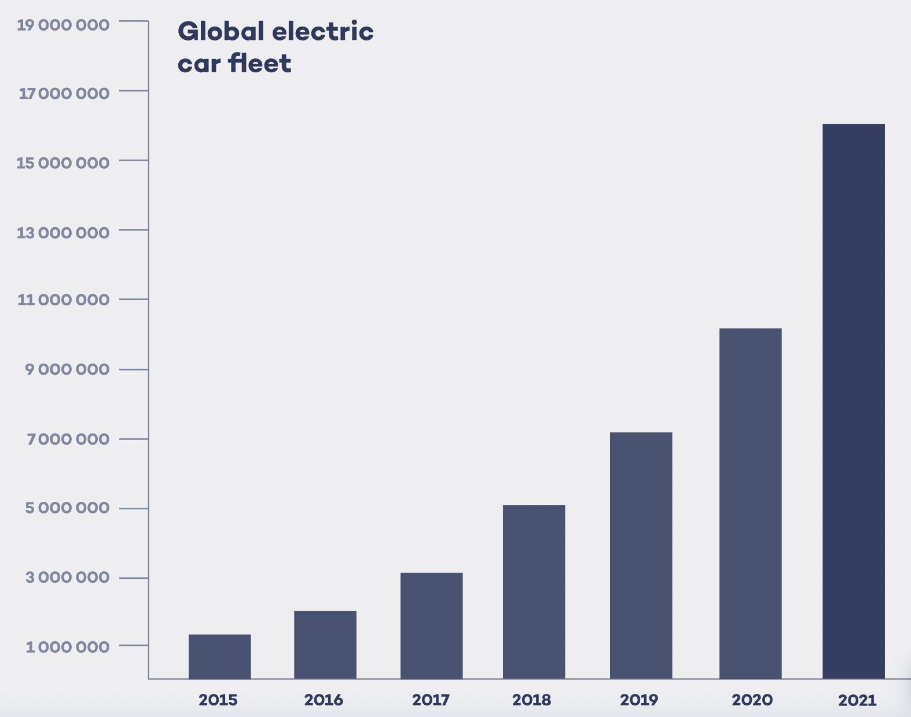
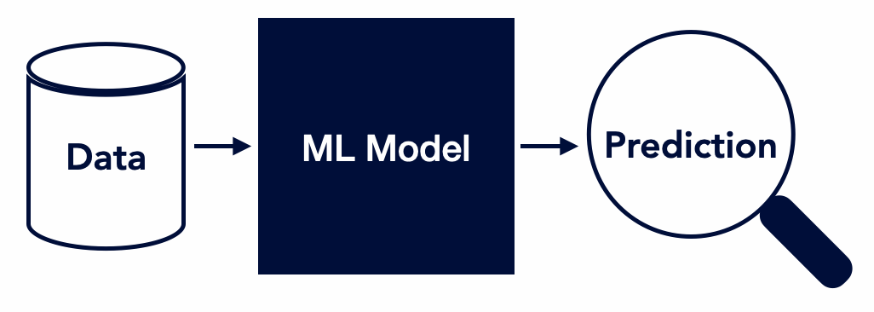
Context
The electricity grid will face large constraints from the energy transition:
Increase in volatile renewable energies
Cars transitioning from fossil fuel to electricity
Accurate forecasting models is a key factor
The forecast-models are made up by machine learning models such as :
Long Short-Term Memory networks (LSTM)
Convolutional Neural Network (CNN)

Slide 5
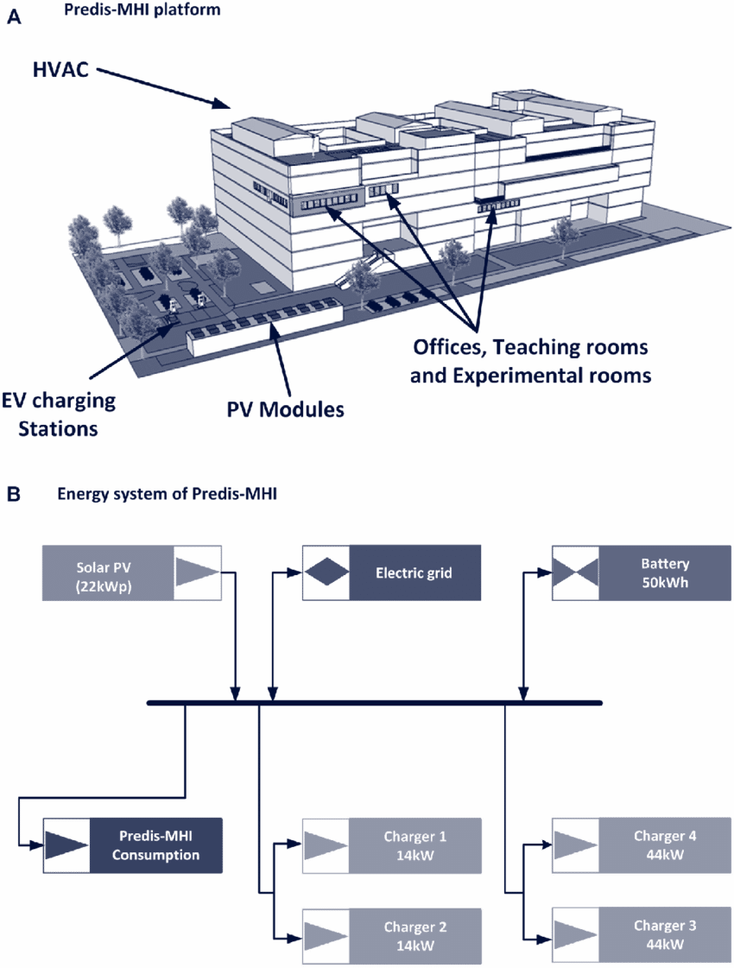
Objective
Last years group’s objective
Ours? -> B9870uild predictive models with machine learning for an MPC to forecast charging load of EV chargers
Models aim to improve the MPC ->
Increase the self consumption of the Predis-MHI platform.
The EV-charging stations are situated in the parking lot of the engineering school Grenoble-INP ENSE3
Our objective will be not only to study these machine learning models but also adapt them and optimize them
Goal :
Create an accurate model to forecast EV-charging load

Slide 6

02
Methodology

Slide 7
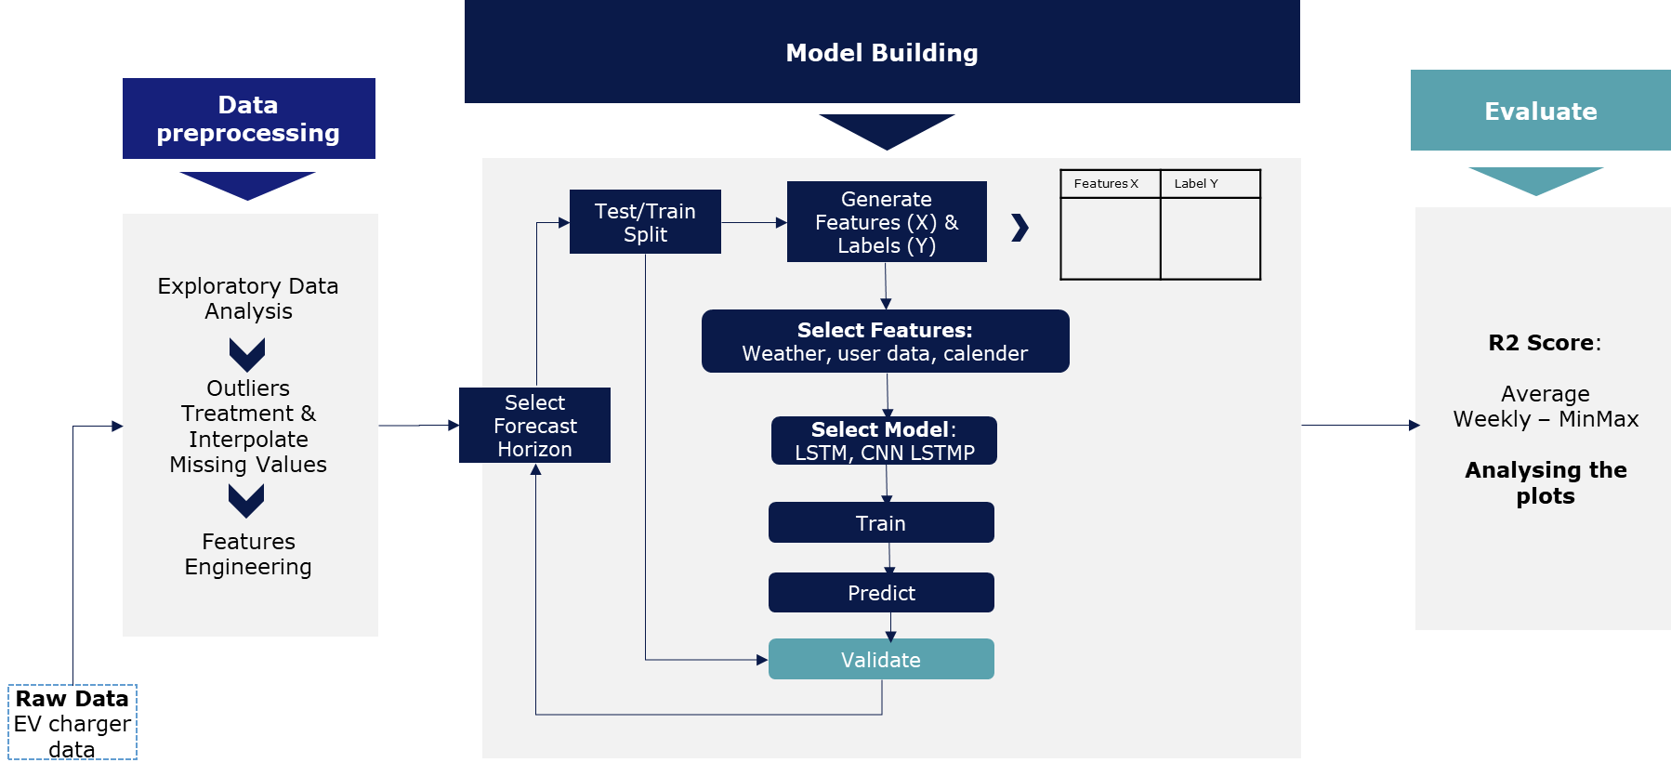
Methodology
Predicting the actual consumption

Slide 8
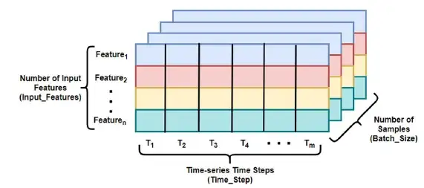
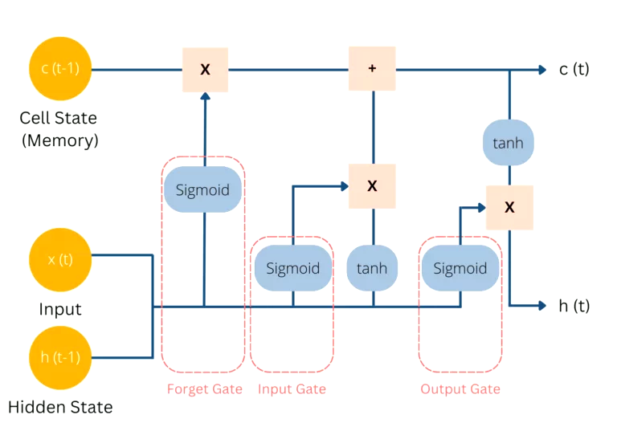
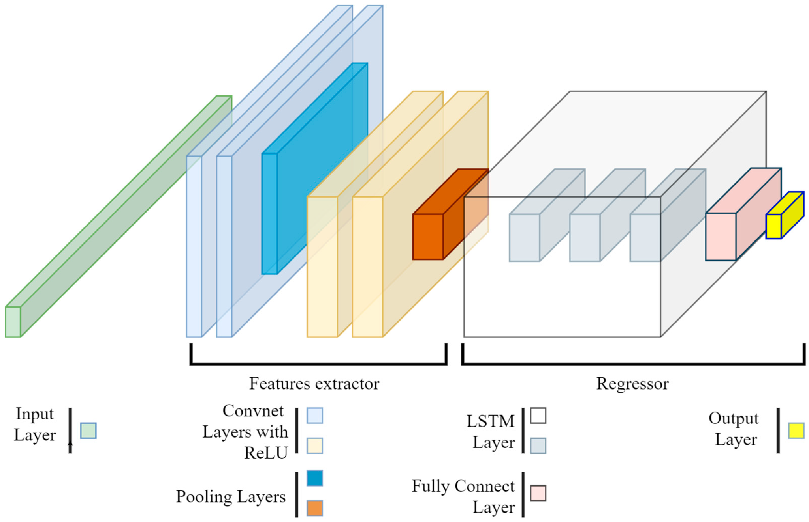
Methodology
LSTM & CNN-LSTM
LSTM Architecture
CNN-LSTM Architecture

Slide 9
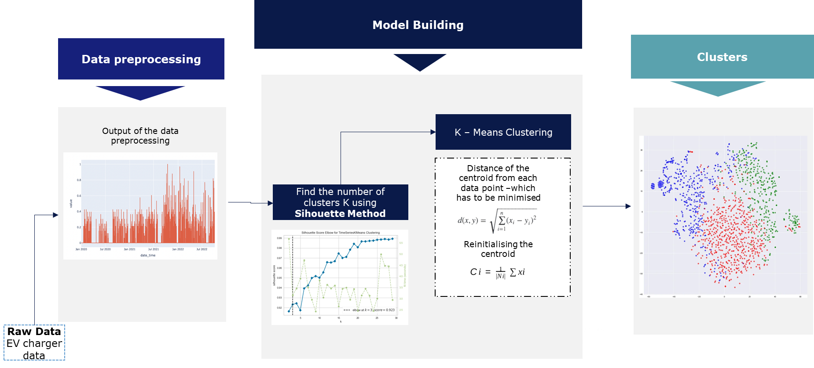
Methodology
k-means clustering

Slide 10
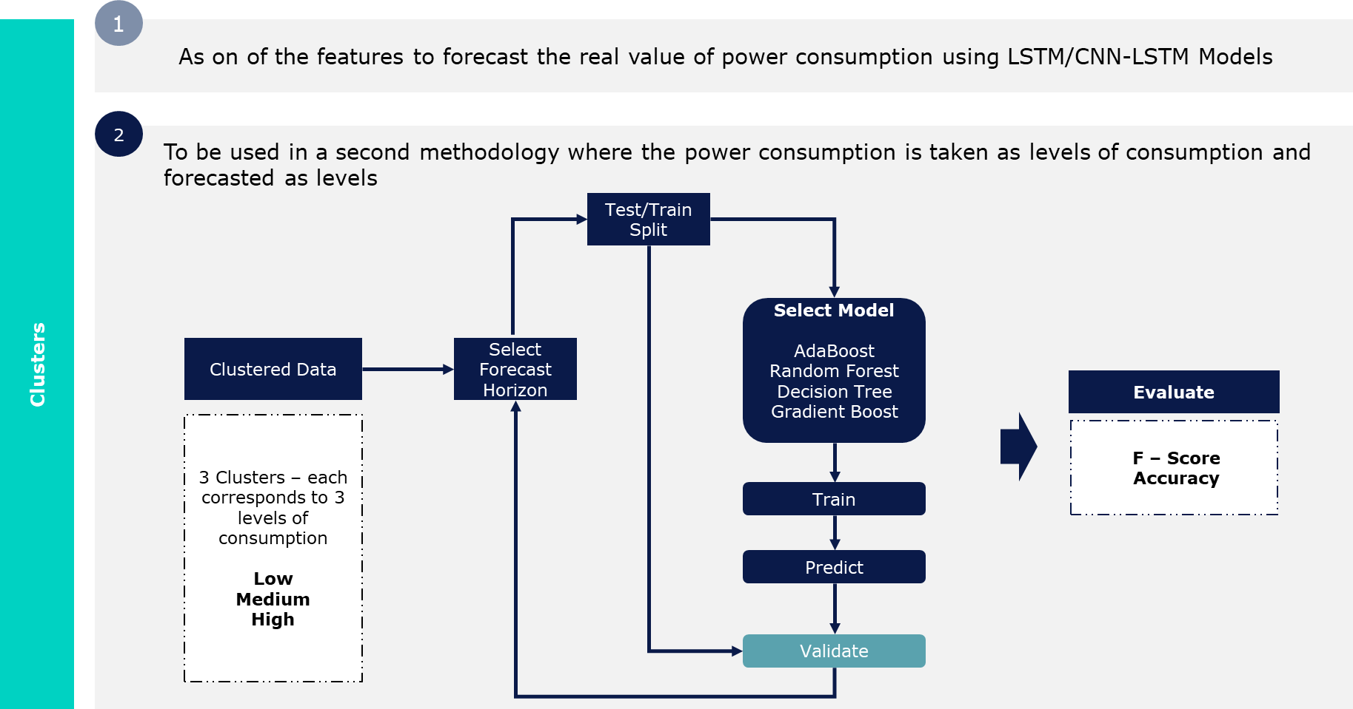
Methodology
How are the clusters used ?

Slide 11

03
Results

Slide 12
Results
 | R-score
Without clustering | Model | 1 Hour | 3 Hours | 6 Hours | 12 Hours | 24 Hours
 | LSTM consumption only | 0,1517 | 0,0713 | -0,0388 | -0,1169 | 0,0038
 | CNN LSTM consumption only | 0,2238 | 0,1211 | 0,0656 | 0,0084 | -0,0306
 | CNN LSTM cons+ solar no future | 0,1858 | 0,1080 | 0,0281 | -0,0023 | -0,0865
 | CNN LSTM cons+ solar future data | 0,1824 | 0,0906 | 0,0206 | 0,0007 | -0,0871
 | CNN LSTM cons+ temperature no future | 0,1566 | 0,0925 | 0,0019 | -0,0023 | -0,0905
 | CNN LSTM cons+ temperature future data | 0,1472 | 0,0874 | -0,0044 | -0,0022 | -0,0907
 | CNN LSTM cons + calendar no future | 0,2336 | 0,1023 | 0,0643 | -0,0023 | -0,0886
 | CNN LSTM cons + calendar future data | 0,2770 | 0,1186 | 0,0934 | 0,0321 | -0,0845
 | CNN LSTM cons + calendar future data with one week to predict | -0,0269 | - | - | - | -
 | CNN LSTM cons+ calendar+ temperature future data | 0,2584 | 0,1262 | - | - | -
 | CNN LSTM cons+calendar+habits with future | 0,2701 | 0,0618 | 0,0852 | 0,0234 | -0,0912
With Clustering | CNN LSTM cons + cluster | 0.0227 | - | - | - | -
Results are obtained for the LSTM and CNN LSTM model.
Since CNN-LSTM was most promising we researched features to improve it:
Solar irradiance
Temperature
Calendar
Use of future data improved the models
Prediction CNN LSTM + cluster not interesting: very low R-Score
Prediction quality is poor and degrades a lot after 1H.
R-Score of the different ML models with varying features

Slide 13
Results
Model Name | Cluster Class | F - Score | Accuracy
Gradient Boost | Class 0 | 0.97 | 0.95
 | Class 1 | 0.07
 | Class 2 | 0.11
Random Forest | Class 0 | 0.97 | 0.95
 | Class 1 | 0.08
 | Class 2 | 0.08
Adaboost | Class 0 | 0.97 | 0.95
 | Class 1 | 0.12
 | Class 2 | 0.04
Decision Tree | Class 0 | 0.97 | 0.94
 | Class 1 | 0.14
 | Class 2 | 0.03
Looking at cluster result :
Value count of different classes : 23009, 997, and 203 respectively.
High accuracy but can’t be used because low value count of class 1 and class 2 (medium and high consumption)
F-score shows bad prediction of medium and high consumption
Performance of difference classifier predictor models

Slide 14

04
Analysis of Results

Slide 15
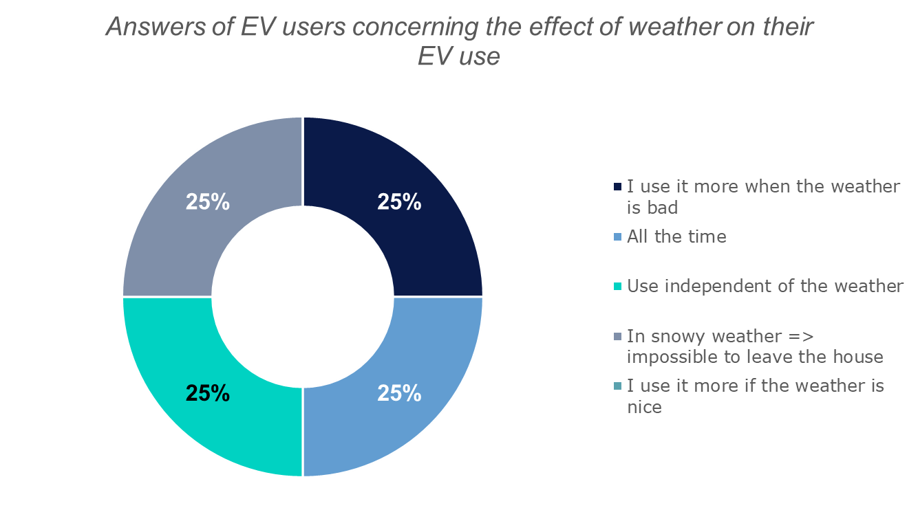
Analysis of results
Explaining the poor results compared to last year work:
Poor performance of models is due to the varying degree of quality of the input time series data.
Current EV data has a high volume of zeroes about 98%, thus making the EV usage appear like a random walk with widespread random use of EV chargers making it almost impossible to predict.
Same issue with clustering.
Influence of the features on the results:
Meteorological features had a worse score than without them. Suggests that these features have no clear correlation to the EV users' behavior regarding whether to use the chargers or not.
Notes:
with widespread random use of EV chargers making it almost impossible to predict.
The classifier prediction models predict the Class 0 corresponding to low/zero EV consumption level with a high degree of accuracy whereas the medium and high levels of consumption are very poorly predicted

Slide 16
Analysis of results
Influence of the features on the results:
Meteorological features do not increase performances of the model
Calendar is the most important feature by increasing the overall R-score the most. Its impact can be seen in all feature combinations where it is present
But, lowest R-2 score occurs during the summer holidays and end-of-year holidays.
Our occupancy calendar does not correspond entirely to the workers' schedule → Changing our generalized calendar to the personalized schedule of the school's EV users could increase the impact of this feature.
R-score
Model with the different features tested | 1 Hour | % variation compared to consumption only | 3 Hours | % variation compared to consumption only
CNN LSTM consumption only | 0,2238 | - | 0,1211 | -
CNN LSTM cons+ solar no future | 0,1858 | -16,98% | 0,1080 | -10,82%
CNN LSTM cons+ solar future data | 0,1824 | -18,50 % | 0,0906 | -25,18%
CNN LSTM cons+ temperature no future | 0,1566 | -30,03% | 0,0925 | -23,62%
CNN LSTM cons+ temperature future data | 0,1472 | -34,23% | 0,0874 | -27,83%
CNN LSTM cons + calendar no future | 0,2336 | +4,38 % | 0,1023 | -15,52%
CNN LSTM cons + calendar future data | 0,2770 | +23,77 % | 0,1186 | -2,06 %
CNN LSTM cons+ calendar+ temperature future data | 0,2584 | +15,46 % | 0,1262 | +4,21 %
CNN LSTM cons+calendar+habits with future | 0,2701 | +20,69 % | 0,0618 | -48,96%
Influence of features- Increase or decrease of R-Score for 1H and 3H prediction
Notes:
calendar feature reduces a lot of the otherwise big error sources such as covid-lockdowns, vacations, and closing hours. It is because of the clear connection between occupancy at school and the number of EVs parked these days and hours.

Slide 17
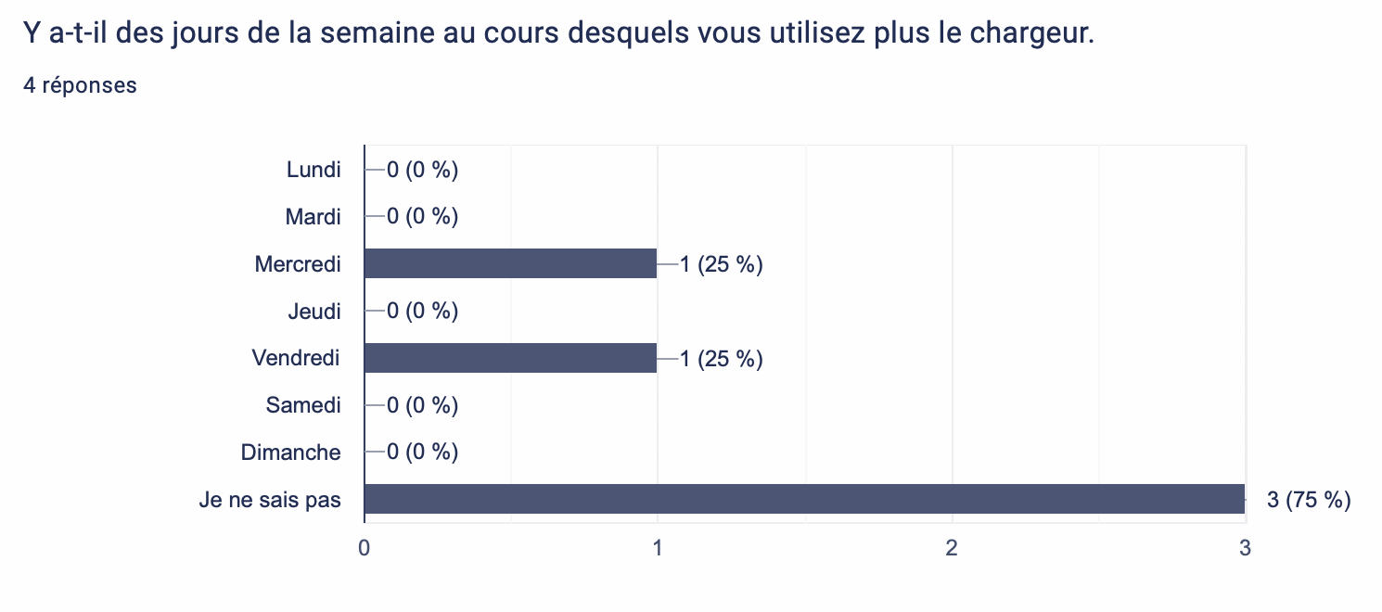
Analysis of results
Habit features give interesting results but not as much as expected: why ?
We assessed this feature with a survey which resulted in only four total answers where two of which were "I do not know"
Too few to achieve an accurate representation of specific user habits
Half, were "I do not know". These "do not know" diminish the impact of the other answers which would increase the features' relevance.
To improve this feature the survey should have been sent out earlier to obtain a higher response rate. In addition, an increase in charger users would greatly strengthen and clarify trends.
Answers of EV users concerning charging patterns
Notes:
A higher participation percentage of the total EV users at school (estimated around twelve) should be necessary to identify a charging habit pattern.

Slide 18

05
Conclusion & Perspective

Slide 19
Conclusion & Perspectives
Summary:
Analysing the datas → Preprocessing → Normalizing
Searching and implementing new features → Evaluation of their performances.
Implementation of different models with a better performance on the CNN-LSTM
Trying to improve our approach with clustering which could be explored thoroughly next year.
Challenges :
Understanding the datas and the previous code
Lack of “good datas”
Long computation time

Slide 20




Perspectives of evolution
User data
EV sales are increasing rapidly globally and in France.
Using AI to forecast the future load

Slide 21
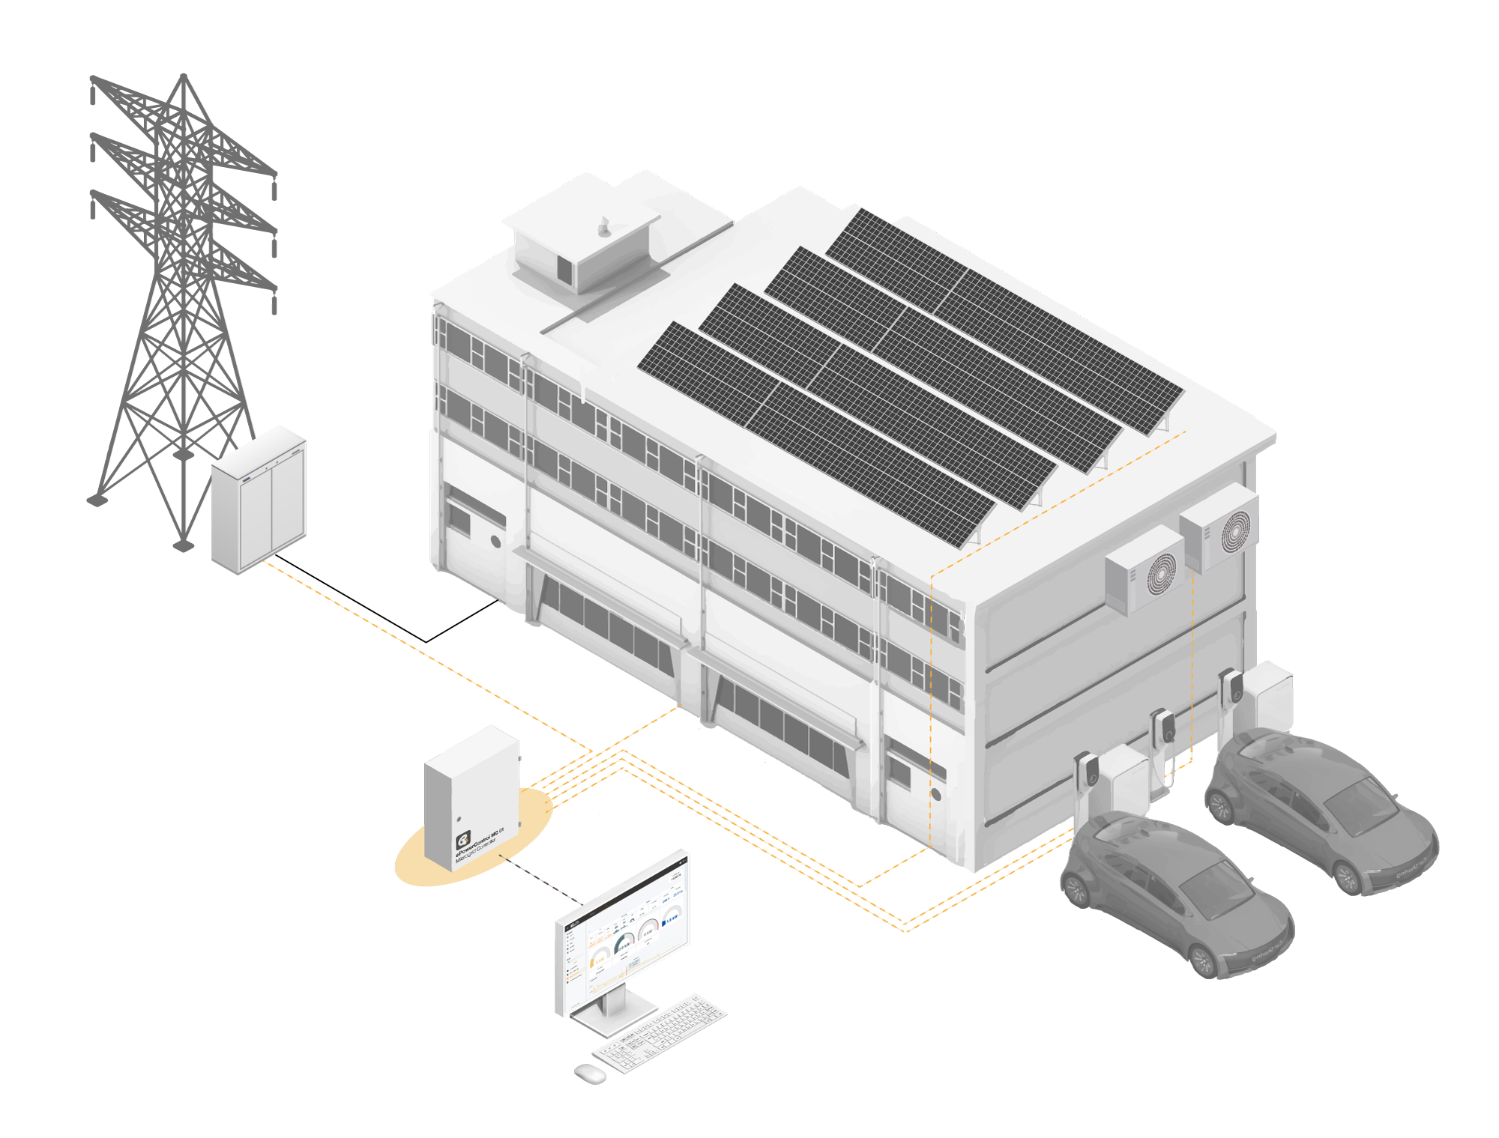
Thank you!
Authors
Oscar Wahlström oscar.wahlstrom@grenoble-inp.org
Camille Fournier camille.fournier2@grenoble-inp.org
Yann Le Floch yann.le-floch2@grenoble-inp.org
Anujraaj Gopalsamy Sakthivel anujraaj.gopalsamy-sakthivel@grenoble-inp.org
Supervisors
Manar Amayri manar.amayri@grenoble-inp.fr
Nana Kofi Baabu Twum Duah nana-kofi-baabu.twum-duah@g2elab.grenoble-inp.fr

